Slide 1



AI Code Review Assistant
By -
Perumalla Dharan (AP21110010201)
NVSS Pavan Sastry (AP21110010209)
Vatala Phalgun (AP21110010223)
Grandhi Dinesh (AP21110010240)

Slide 2


Challenges in traditional code review process
Time Consuming
Inconsistent
Missed Errors

Slide 3


What does it do?
Runs the given code
Provides Summary of the code

Slide 4


Benefits of using AI code review assistant
Automatic Code Summarization
Multiple programming languages support

Slide 5
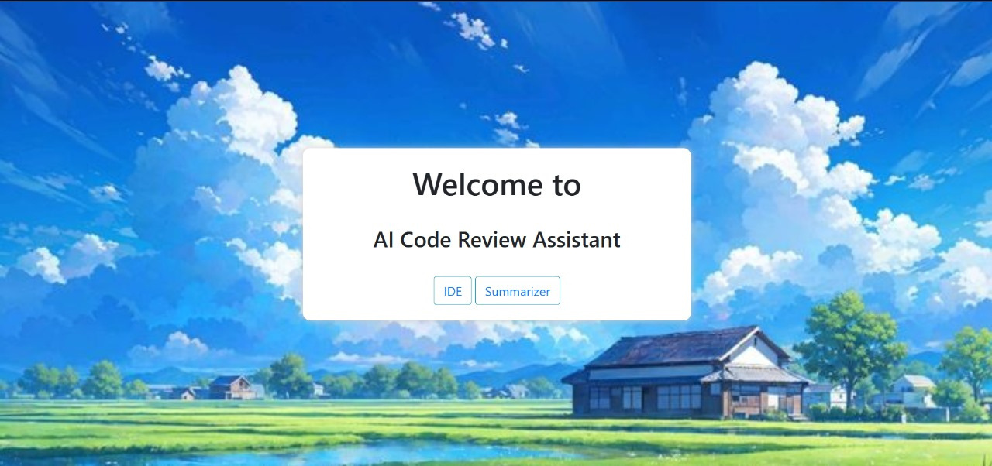
Webpage

Slide 6
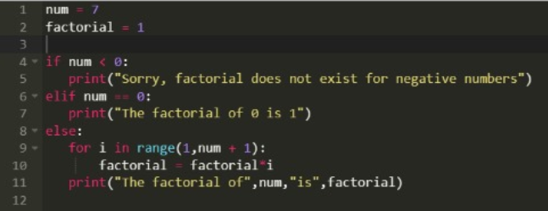
IDE
Input

Slide 7
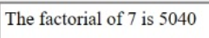
IDE
Output

Slide 8
Summarizer
Input

Slide 9
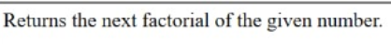
Summarizer
Output

Slide 10


Scope of Project
Code refinement
Provide User login authentication system

Slide 11
Thank You!

